Slide 1
Developing Kafka Applications – Consumer API

Slide 2


Consumers and Consumer Groups
Consumer
Applications that read data from Kafka are consumers
Subscribes to topics
Use KafkaConsumer to read messages from these topics
Kafka consumers are usually part of a consumer group
The main way consumption of data from a Kafka topic is scaled is by adding more consumers to a consumer group

Slide 3
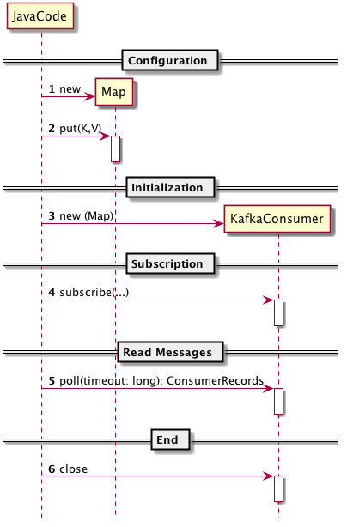
Java API Behavior
// Configuration
Properties kp = new Properties();
kp.put("bootstrap.servers",
"mybroker1:9092,mybroker2:9092");
kp.put("key.deserializer", "...");
// Initialization
KafkaConsumer<...> consumer=
new KafkaConsumer<...>(kp);
// Subscription
consumer.subscribe("interesting.*");
// Read messages
ConsumerRecords<...> records = producer.poll(100);
for (ConsumerRecord<...> cr : records) {
// cr.value(); cr.key(); cr.offset();
}
// End
consumer.close()

Slide 4
The Java API
Generic sender where:
K = Type of key
V = Type of message
Constructor takes a configuration (mostly a hashmap of options)
org.apache.kafka.clients.consumer
Multiple ways to subscribe. Subscribe by list, wildcard, etc.
KafkaConsumer<K,V>
KafkaConsumer(config: Properties)
subscribe(...)
poll(timeout: long): ConsumerRecords<K,V>
commit...(...)
...
Read messages from Kafka
Multiple (sync/async) ways to confirm reception to consumer groups
A set of other methods such as: metrics(), pause(...), assign(...), close(), etc

Slide 5
How to Use the API?
The org.apache.kafka.clients.consumer.KafkaConsumer acts as a proxy for the consumer
Some key issues to to resolve
Setup of consumer groups
Which topics to subscribe to
Which partitions to subscribe to (optional)
Manual or automatic offset management
Multi-threaded or single-threaded consumption

Slide 6
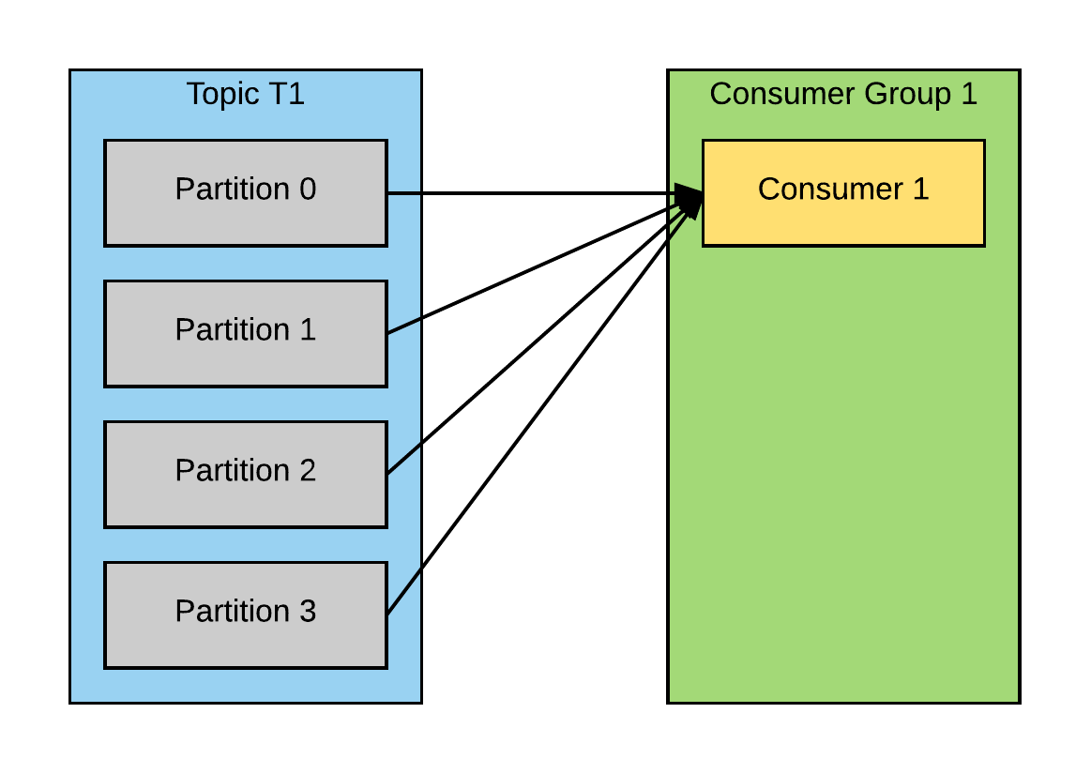
Consumer Group
The consumer will receive all messages from all four partitions

Slide 7
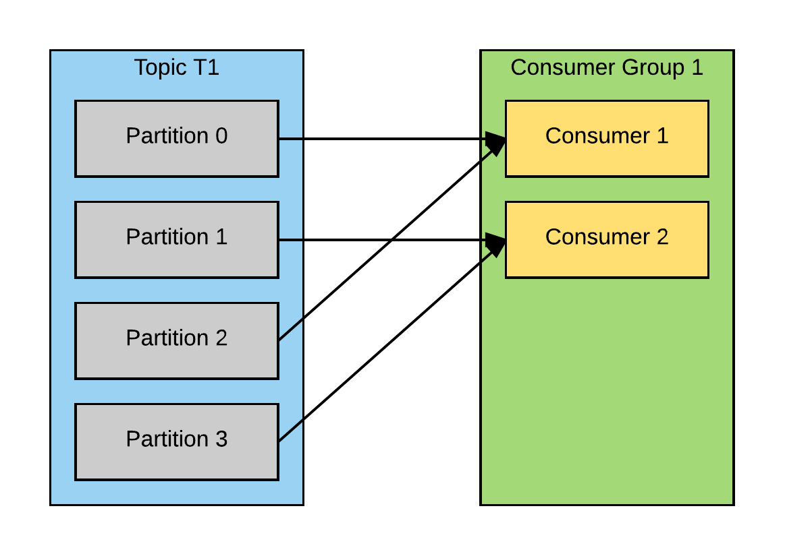
Consumer Group
Each consumer will only get messages from two partitions

Slide 8
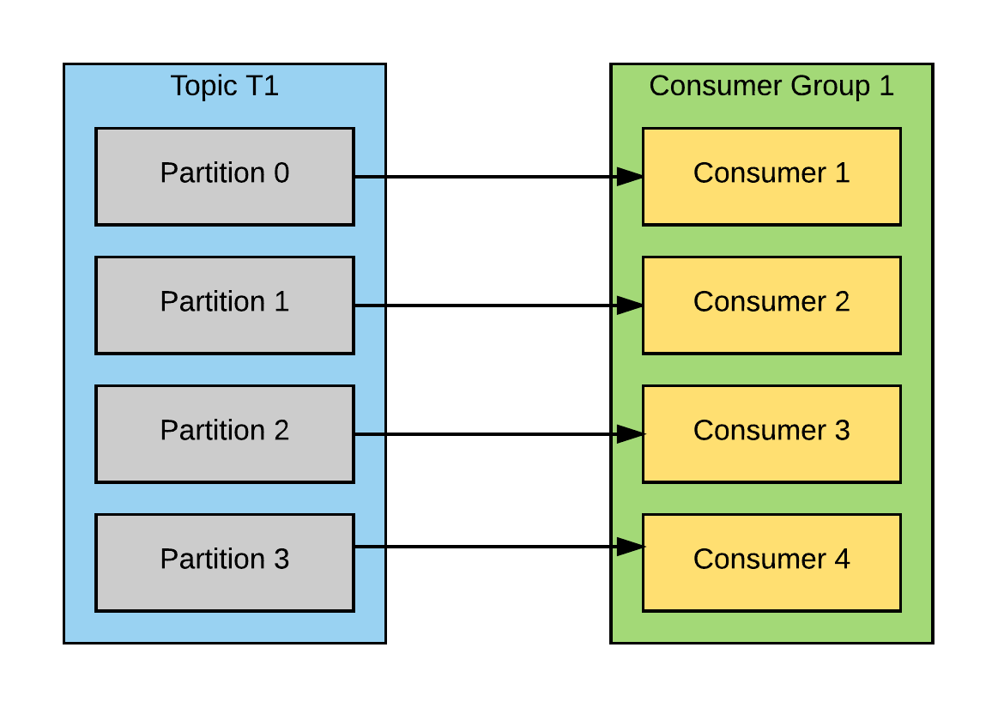
Consumer Group
If the consumer group has the same number of consumers as partitions, each will read messages from a single partition

Slide 9
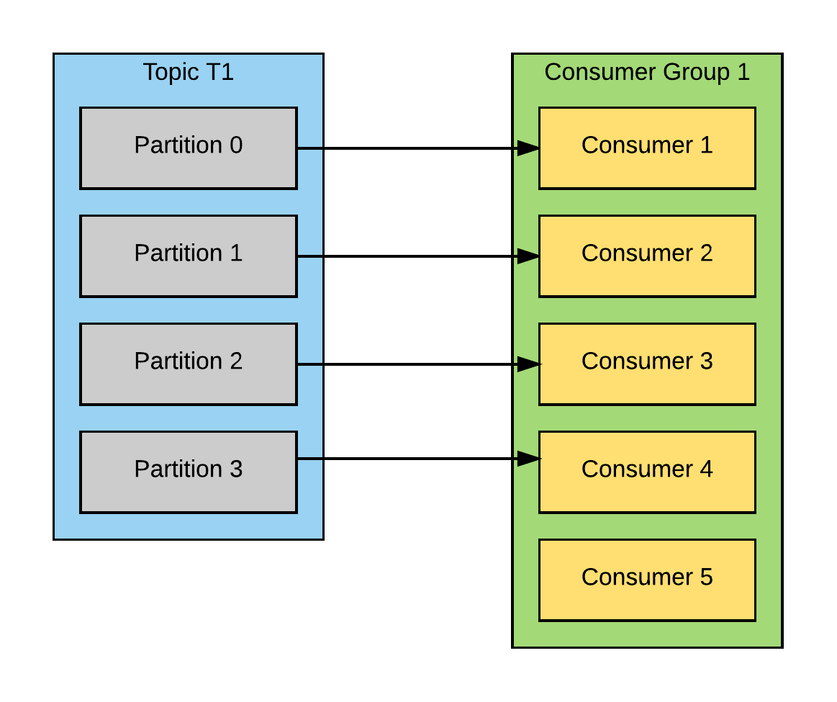
Consumer Group
If there are more consumers than partitions for a topic, some consumers will be idle and receive no messages
Create topics with a large number of partitions to allow adding more consumers when load increases

Slide 10
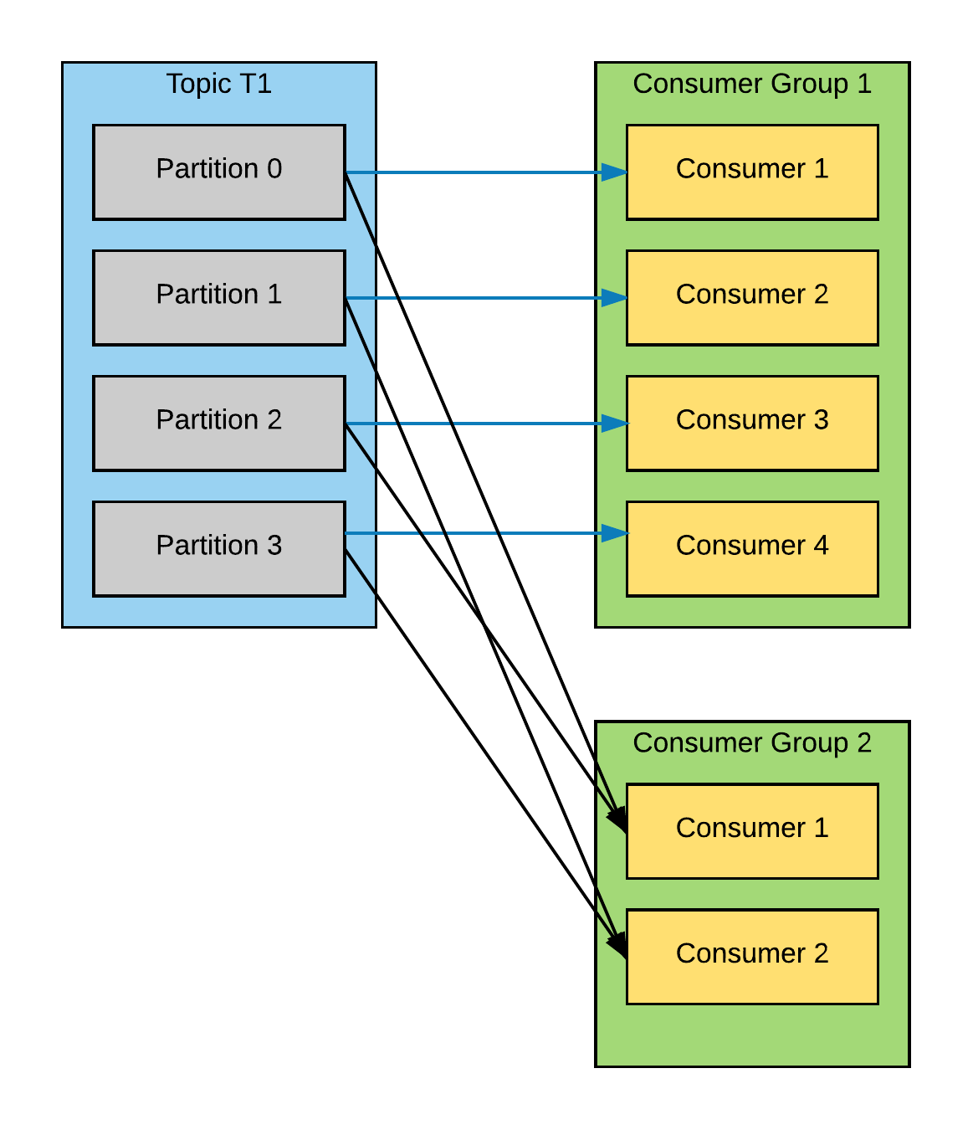
Multiple Consumer Groups
One of the main design goals of Kafka was to allow multiple applications the ability to read data from the same topic
Make sure each application has its own consumer group for this purpose

Slide 11
Partition Rebalance
Consumers in a consumer group share ownership of the partitions in the topics they subscribe to
When a new consumer is added to the group, it consumes messages from partitions which were previously consumed by another consumer
When a consumer leaves the group (shuts down, crashes, etc), the partitions it used to consume will be consumed by one of the remaining consumers
Reassignment of partitions to consumers can also happen when topics are modified – an administrator adds new partitions, for example

Slide 12
Partition Rebalance
The event in which partition ownership is moved from one consumer to another is called a rebalance
During a rebalance, consumers can't consume messages!
Steps can be taken to safely handle rebalances and avoid unnecessary rebalances

Slide 13
Creating a Kafka Consumer
Creating a KafkaConsumer is similar to creating a KafkaProducer
Like the producer, you must specify bootstrap.servers, key.deserializer, and value.deserializer in a Properties object
You must also specify a group.id which specifies the consumer group for which the KafkaConsumer instance belongs to

Slide 14
Setup of KafkaConsumer Example
private properties kafkaProps = new Properties();
kafkaProps.put("bootstrap.servers", "mybroker1:9092,mybroker2:9092");
kakfaProps.put("key.serializer", "org.apache.kafka.common.serialization.StringSerializer");
kakfaProps.put("value.serializer", "org.apache.kafka.common.serialization.StringSerializer");
kafkaProps.put("group.id", "StateCounter");
KafkaConsumer<String, String> consumer = new KafkaConsumer<String, String>(kafkaProps);

Slide 15
Subscribing to Topics
Once a consumer is created, you can subscribe to one or more topics
consumer.subscribe(Collections.singletonList("customerStates"));
We create a list with a single element, the topic name "customerStates"

Slide 16
Subscribing with Regular Expressions
You can also subscribe to topics using regular expressions
The expression can match multiple topic names
If a new topic is created with a name that matches, a rebalance will happen and consumers will start consuming from the new topic
Useful for applications that need to consume from multiple topics
Example: subscribe to all test topics
consumer.subscribe("test.*");

Slide 17
Consumer Poll Loop
Once a consumer subscribes to topics, a loop polls the server for more data
KafkaConsumer<String, String> consumer = new KafkaConsumer<>(props);
consumer.subscribe(Arrays.asList("foo", "bar"));
while (true) {
ConsumerRecords<String, String> records = consumer.poll(100);
for (ConsumerRecord<String, String> record : records)
System.out.printf("offset = %d, key = %s, value = %s", record.offset(), record.key(), record.value());
} finally {
consumer.close();
}
Consumers must keep polling Kafka or they will be considered dead and the partitions they are consuming will be handed to another consumer in the group

Slide 18
Poll Method
poll() returns a list of records that contain:
Topic and partition the record came from
Offset of the record within the partition
Key and value of the record
Takes a timeout parameter that specifies how long it will take to return, with or without data
How fast do you want to return control to the thread that does the polling?

Slide 19
Poll Internals
Behind the scenes of poll():
First time poll() is called with a new consumer: finds the GroupCoordinator, joins the consumer group, and receives a partition assignment
If a rebalance is triggered, it is also handled inside the poll loop
Heartbeats that keep consumers alive are sent
Processing between iterations must be fast and efficient

Slide 20
Multithreading Considerations
One consumer per thread
To run multiple consumers in the same group in one application, each must run in its own thread
You can wrap the consumer logic in its own object and then use Java's ExecutorService to start multiple threads each with its own consumer

Slide 21
Commits
Unlike other JMS queues, Kafka does not track acknowledgements from consumers
When poll() is called, it returns records that consumers in the group have not yet read
The records that have been read by a consumer of the group are tracked by their position (offset) in each partition
When the current position in the partition is updated, it is known as a commit

Slide 22
Consumers Commit Offsets
Consumers send a message to Kafka to a reserved topic with the committed offset for each partition
If a consumer crashes or a new consumer joins the consumer group, a rebalance is triggered
After a rebalance, a consumer may be assigned a new set of partitions and must read the latest committed offset of each partition and continue from there

Slide 23
Automatic Commit
If you configure enable.auto.commit=true, the consumer will commit the largest offset your client received from poll() every 5 seconds by default
Whenever there is a poll, the consumer checks if its time to commit and if so, will commit the offsets it returned in the last poll
Convenient but don't give developers enough control to avoid duplicate messages

Slide 24
Commit Current Offset
Developers usually want to exercise control over the time offsets are committed to eliminate possibility of missing messages and reduce the number of duplicate messages during rebalancing
Setting auto.commit.offset=false means that offsets will only be committed explicitly
Consumer has a commitSync() API to commit the latest offset returned by poll()

Slide 25
commitSync Example
while (true) {
ConsumerRecords<String, String> records = consumer.poll(100);
for (ConsumerRecord<String, String> record : records)
System.out.printf("offset = %d, key = %s, value = %s", record.offset(), record.key(), record.value());
try {
consumer.commitSync();
} catch (CommitFailedException e) {
log.error("commit failed", e);
}
} finally {
consumer.close();
}
Once we are done processing all records in the current batch, commitSync is called before polling for more

Slide 26
Asynchronous Commit
The application is blocked until the broker responds to the commit request with commitSync() limiting throughput
An alternative is to use commitAsync() which commits the last offsets and continues
while (true) {
ConsumerRecords<String, String> records = consumer.poll(100);
for (ConsumerRecord<String, String> record : records)
System.out.printf("offset = %d, key = %s, value = %s", record.offset(), record.key(), record.value());
consumer.commitAsync();
}
You can also pass a callback which is invoked by the consumer when the commit finishes (either successfully or not)

Slide 27
Commit Specified Offset
commitSync() and commitAsync() allow you to pass a map of partitions and offsets that you want to commit
Useful if poll() returns a large batch and you want to commit offsets in the middle of the batch to avoid having to process all those rows again if a rebalance occurs

Slide 28
Commit Specified Offset Example
private Map<TopicPartition, OffsetAndMetadata> currentOffsets;
int count = 0;
while (true) {
ConsumerRecords<String, String> records = consumer.poll(100);
for (ConsumerRecord<String, String> record : records)
{
System.out.println("topic = %s, partition = %s, offset = %d, customer = %s, country = %s\n", record.topic(), record.partition(), record.offset(), record.key(), record.value());
currentOffsets.put(new TopicPartition(record.topic(), record.partition()), record.offset());
if (count % 1000 == 0)
consumer.commitSync(currentOffsets);
count++;
}
}
Map to track offsets
Update offsets map after reading each record
Commit current offsets every 1000 records. You could choose to commit based on time or even content of the records

Slide 29
Seek Processing
seekToBeginning(TopicPartition tp)
Start reading all messages from the beginning of the partition
seekToEnd(TopicPartition tp)
Skip all the way to the end of the partition and start consuming only new messages
seek(TopicPartition tp, long offset)
Allows you to specify the offset that the consumer should use
Useful if you happen to be storing offsets in a different database

Slide 30
Deserializers
Kafka producers require serializers to convert Java objects into byte arrays that are sent to Kafka
Kafka consumers require deserializers to converte byte arrays received from Kafka into Java objects
Make sure that the serializer that was used in producing events to Kafka matches the deserializer that will be used when consuming events!

Slide 31
Configuring Consumers
Like the producer, a Kafka consumer's mandatory configuration properties are minimal
bootstrap.servers
group.id
key.deserializer
value.deserializer
Let's take a look at a few to be mindful of for performance reasons though..

Slide 32
fetch.min.bytes
Allows a consumer to specify the minimum amount of data that it wants to receive from the broker when fetching records
If the broker receives a request for records from a consumer but the new records amount to fewer bytes than specified, the broker will wait until more messages are available
Reduces load on the consumer and broker

Slide 33
max.partition.fetch.bytes
Controls the maximum number of bytes the server will return per partition
Default is 1MB
When the consumer poll() returns records, the record object will be at most max.partition.fetch.bytes per partition assigned to the consumer

Slide 34
session.timeout.ms
Amount of time a consumer can be out of contact with the brokers while still considered alive
Defaults to 3 seconds
If a consumer goes for more than this value without sending a heartbeat to the group coordinator, it is considered dead and the group coordinate will trigger a rebalance of the consumer group
The rebalance allocates partitions from the dead consumer to the other consumers in the group

Slide 35
Summary
Consumers and Consumer Groups
Partition Rebalance
Consumer Poll Loop
Commits
Deserializers
Consumer Configuration

Slide 36
Exercise: Define a Kafka Consumer
Docker Container
Java Client
Kafka Broker
Kafka Consumer
poll()
for each msg
print msg
user-events
Read
global-events
Zookeeper
In this exercise we'll consume the messages sent in the previous exercise
If you did not complete the previous exercise, you'll have to do so before starting this exercise...

Slide 37
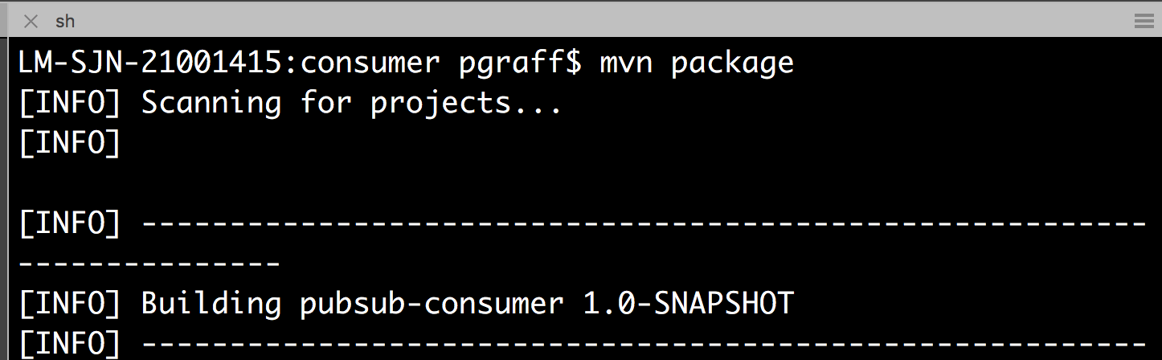
Step 1: Build the Consumer
Open another terminal (just so that we can run the producer again if we want to)
Change into the directory lesson-40-developing-kafka-applications-consumer-api
Run the maven command to build:

Slide 38
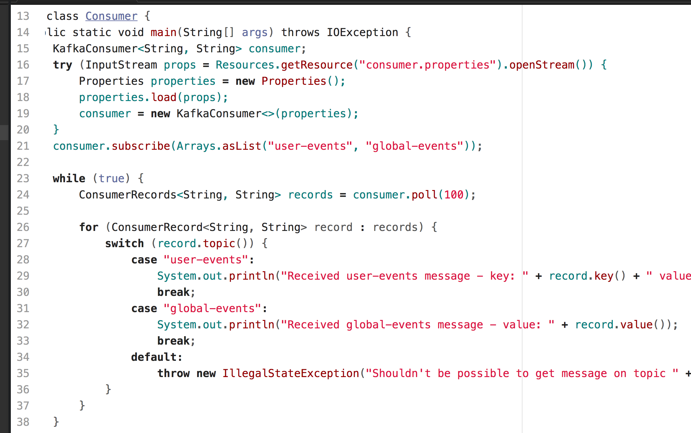
The Consumer

Slide 39
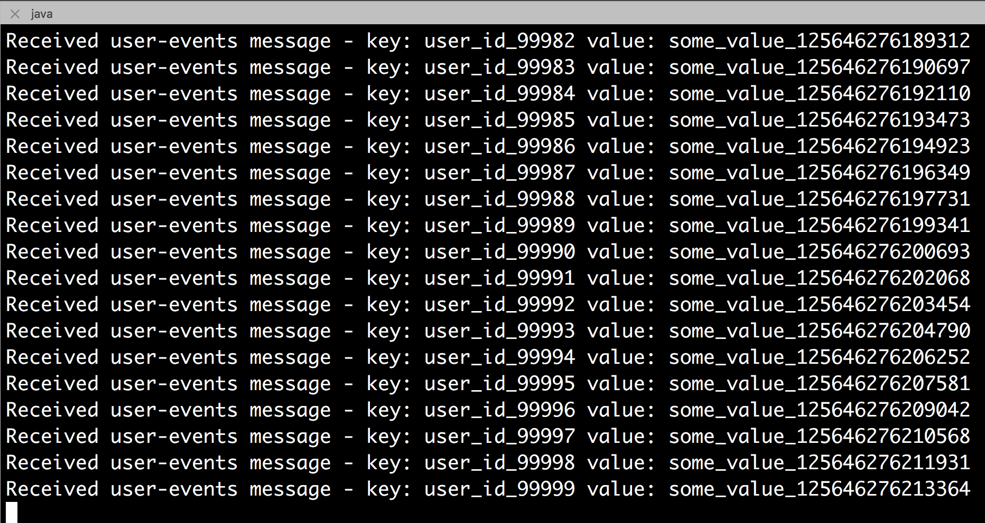
Step 2: Run the Consumer
Run the consumer (it will be able to consume the already produced messages as it is 'playing from the beginning')
The consumer is in target/consumer

Slide 40
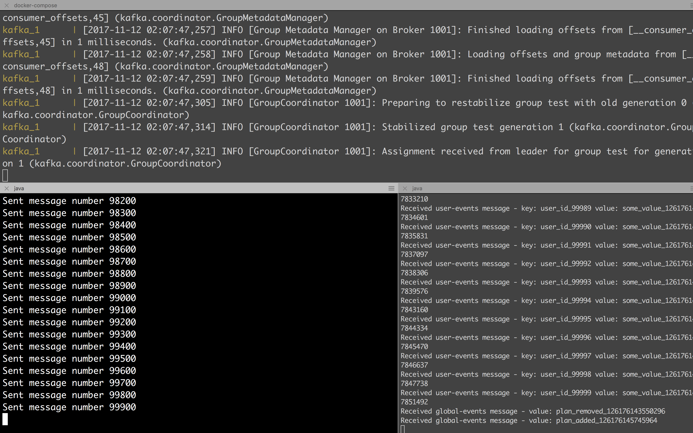
docker-compose Kafka and ZooKeeper
Producer
Consumer

Slide 41
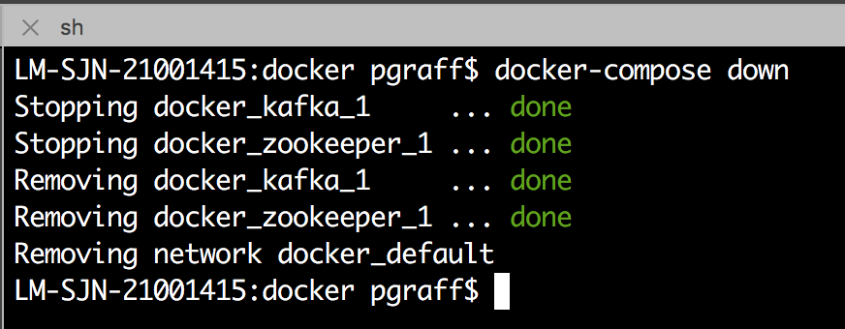
When You’re Done…
Remember to run the docker-compose down

